Slide 1
GUESSING GAME
FIND THE NAME OF A COUNTRY

Slide 2
CLUE 1
It was part of the BRITISH EMPIRE until 1947, when it became independent

Slide 3
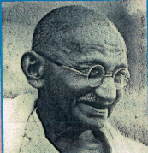
CLUE 2
GANDHI
was an independence leader who used methods of NON VIOLENT protest

Slide 4
CLUE 3
It has the second largest population in the world with
1.38 BILLION INHABITANTS

Slide 5
CLUE 4
It has many regional languages and
two official languages
= ENGLISH and HINDI

Slide 6
CLUE 5
Its capital is… NEW DELHI

Slide 7
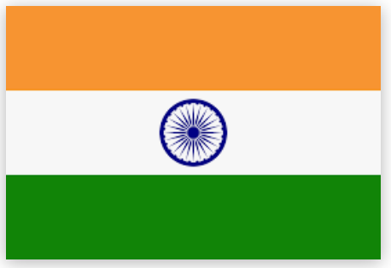
CLUE 6
Its flag:

Slide 8
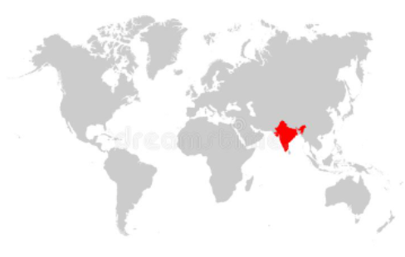
INDIA

